Slide 1
Bones and joints

Slide 2
Bones classification:
Based on Shape
Bone Type | Description | Example
Long Bones | Longer than they are wide; act as levers for movement | Femur, Humerus, Tibia, Radius
Short Bones | Cube-shaped; provide support and stability | Carpals (wrist), Tarsals (ankle)
Flat Bones | Thin, flat, often curved; protect organs and provide attachment surfaces | Skull bones, Sternum, Ribs, Scapula
Irregular Bones | Complex shapes that don’t fit other categories | Vertebrae, Hip bone (coxal), Mandible
Sesamoid Bones | Small, round bones embedded in tendons; reduce friction | Patella (kneecap) is the largest sesamoid
Pneumatic Bones | Contain air spaces to make bones lighter | Maxilla, Ethmoid, Sphenoid, Frontal bone

Slide 3
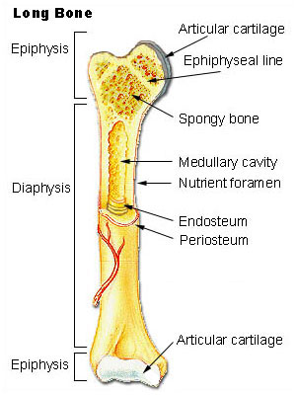
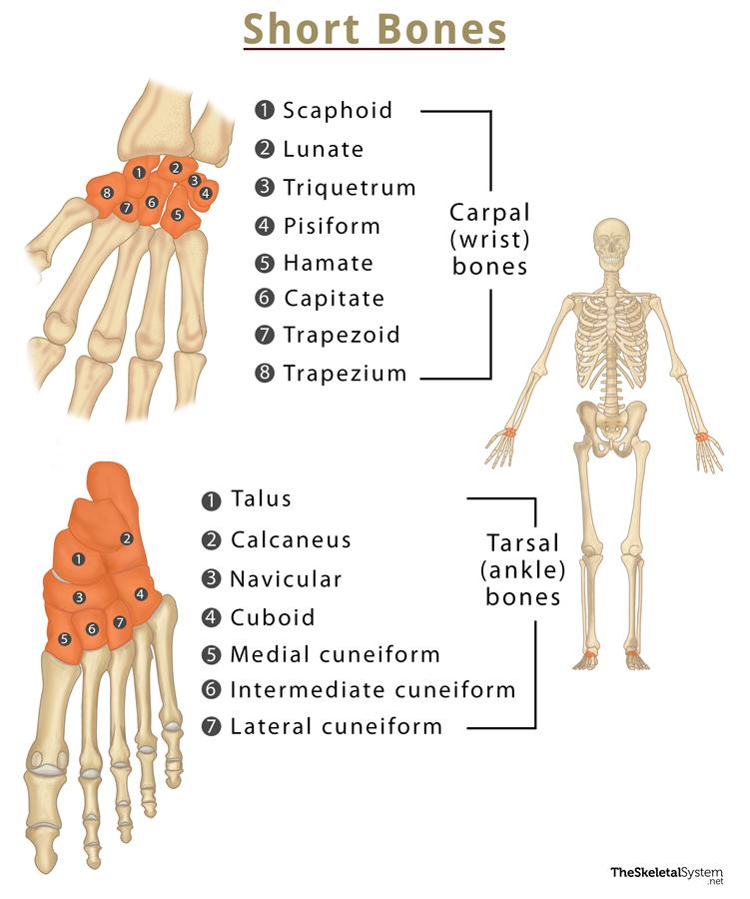
Long bone
Short bone

Slide 4
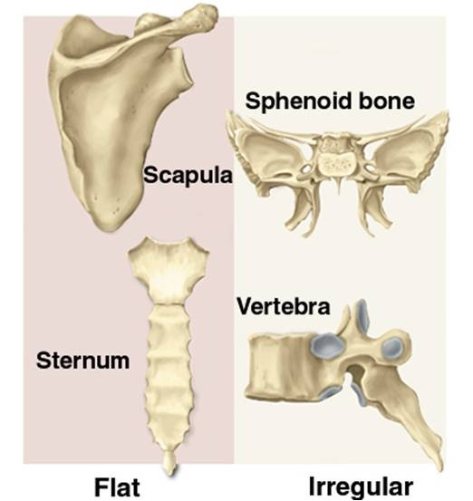
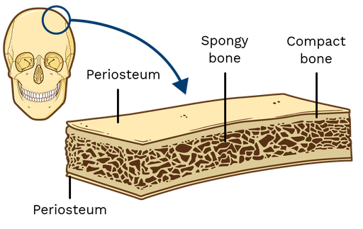
Flat bone
Irregular bone

Slide 5
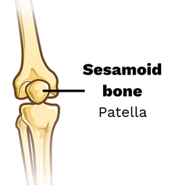
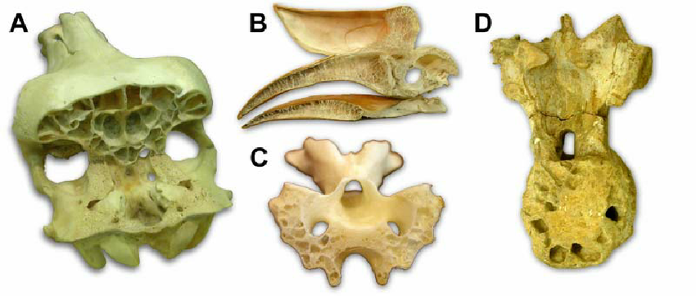
Sesamoid bone
Pneumatic bone

Slide 6
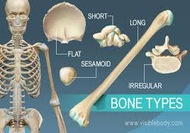

Slide 7
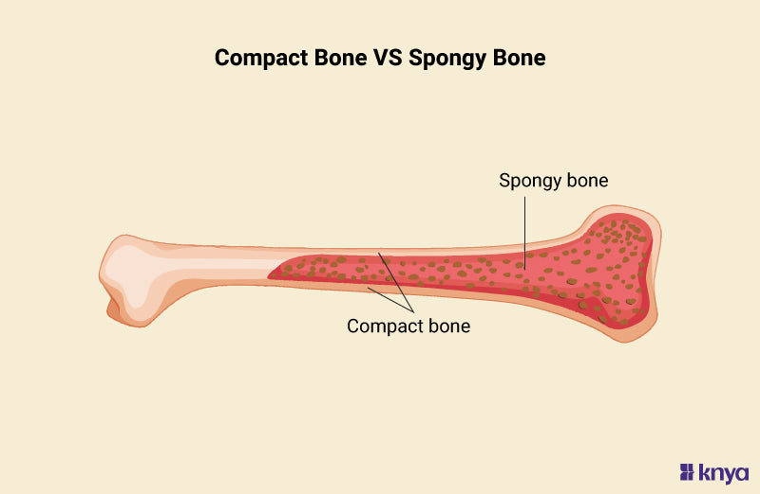
Bones classification:
Based on Internal Structure
Type | Description | Example
Compact (Cortical) Bone | Dense and strong outer layer | Shaft of long bones
Spongy (Cancellous/Trabecular) Bone | Porous and lightweight, contains red marrow | Ends of long bones, interior of flat bones

Slide 8
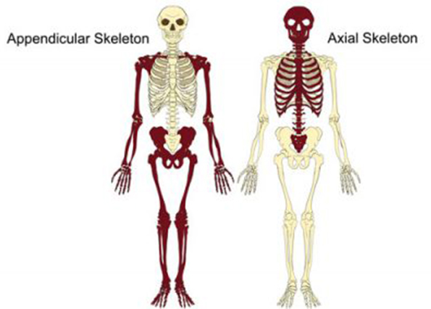
Bones classification:
Based on position
Division | Location & Function | Main Bones Included | Total Bones
Axial Skeleton | Central axis of the body. Protects vital organs like brain, heart, lungs. | Skull, Vertebral Column, Ribs, Sternum | 80 bones
Appendicular Skeleton | Bones of limbs and girdles. Helps in movement and locomotion. | Upper & Lower Limbs, Shoulder Girdle, Pelvic Girdle | 126 bones

Slide 9
Bones classification:
Axial Skeleton (Center)
|— Skull
|— Vertebral Column
|— Ribs + Sternum
Appendicular Skeleton (Attached)
|— Shoulder Girdle + Arms
|— Pelvic Girdle + Legs

Slide 10
Joints classification:
A joint (articulation) is a point where two or more bones meet. Joints allow movement and provide mechanical support.
Classification of Joints
I. Based on Structure (Anatomical Classification)
Type | Connecting Material | Movement | Example
Fibrous Joints | Dense connective tissue | Immovable (Synarthrosis) | Skull sutures, Teeth in sockets
Cartilaginous Joints | Cartilage | Slightly movable (Amphiarthrosis) | Pubic symphysis, Intervertebral discs
Synovial Joints | Synovial cavity + fluid | Freely movable (Diarthrosis) | Knee, Shoulder, Hip

Slide 11
Joints classification:
Types of Fibrous Joints
Type | Description | Example | Movement
1. Sutures | Irregular, interlocking edges of bones connected by short fibers | Skull bones (parietal, frontal, occipital) | Immovable (Synarthrosis)
2. Syndesmosis | Bones connected by a ligament or interosseous membrane | Inferior tibiofibular joint, Radioulnar interosseous membrane | Slight movement (Amphiarthrosis)
3. Gomphosis | Peg-in-socket type joint | Teeth in alveolar sockets (held by periodontal ligament) | Immovable (Synarthrosis)

Slide 12
Joints classification:
Types of cartilaginous joints
Type | Cartilage Type | Description | Example | Movement
1. Synchondrosis (Primary Cartilaginous Joint) | Hyaline cartilage | Temporary or permanent union of bones with hyaline cartilage | - Epiphyseal plate (growth plate in long bones — temporary) - Joint between 1st rib and sternum | Immovable (Synarthrosis)
2. Symphysis (Secondary Cartilaginous Joint) | Fibrocartilage (with hyaline cartilage on surfaces) | Bones are united by a pad of fibrocartilage, allowing slight movement | - Pubic symphysis - Intervertebral discs - Manubriosternal joint | Slightly movable (Amphiarthrosis)

Slide 13
Joints classification:
Types of synovial joint
Joint Type | Movement | Example
Hinge Joint | Flexion and extension | Elbow, Knee, Interphalangeal joints
Ball and Socket Joint | Movement in all directions + rotation | Shoulder, Hip
Pivot Joint | Rotation around an axis | Atlantoaxial joint (neck), Radius-ulna joint (supination/pronation)
Condyloid (Ellipsoid) Joint | Biaxial movement | Wrist joint (Radiocarpal)
Saddle Joint | Biaxial (like riding a saddle) | Thumb joint (Carpometacarpal of 1st digit)
Gliding (Plane) Joint | Sliding movements | Intercarpal, Intertarsal, Vertebral facet joints

Slide 14
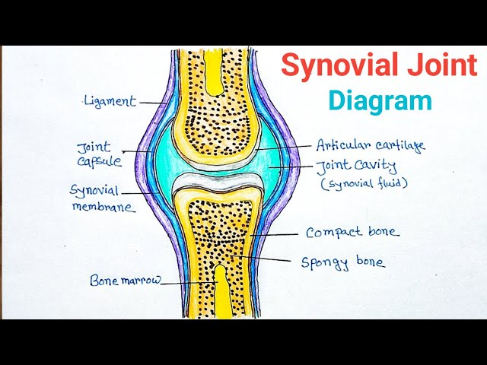
Synovial joint diagram

